Slide 1
Veterinarian
By Lauren Johnson

Slide 2
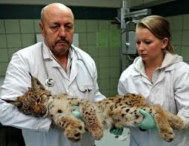
WHY A VET?
I want to research Veterinarians because I love animals. I know creatures get hurt every day and Vets work hard each day to make them better.
Veterinarians are apart of the Health Science Career Cluster

Slide 3

Education and training
REQUIREMENTS
Students must complete a lot of training before they can call themselves a veterinarian.
To be a full-fledged veterinarian, you need 8 -10 years of training.
First, you need a bachelor’s degree in science. This takes 4 years.
Then, you need to earn your DVM (Doctor of Veterinary Medicine) from an accredited college or university. This can take another 4 years.
Students will also work as an intern while they are studying in order to get experience doing the job.
To be a vet assistant you only need 2-4 years of training.
IMPORTANT QUALITIES
You must love animals.
You must be good in science.
You must be a good listener.
You must be a good speaker.
You must be a problem solver.
You must have sensitivity to others.
You must be able to draw conclusions.
You must be able to tolerate a noisy work place.

Slide 4


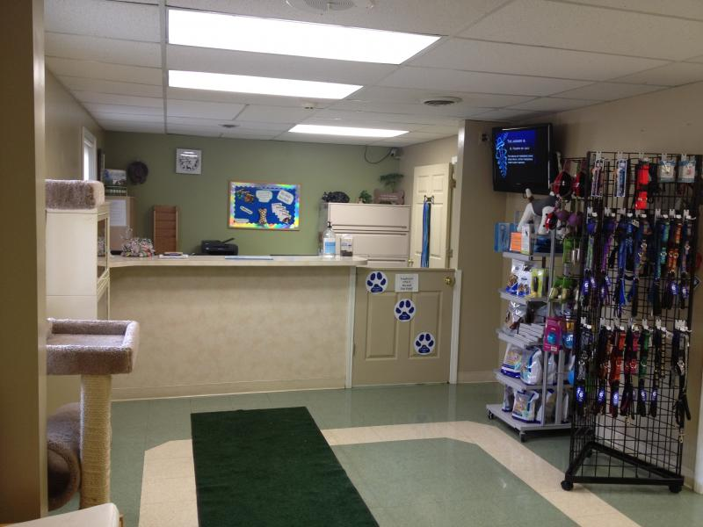
Clothing and work space
BE PREPARED
Veterinarians are known for working long hours, on weeknights and possibly weekends.
Vets can work in a clinic, on a farm, in a zoo and anywhere animals would need a vet.
They usually wear scrubs and a face mask.
They also wear protective gloves so they do not spread germs to the animal or to themselves.
To make sure their hair is not in the way, there is always the option of a hair net!!
A vet can also choose to wear a white doctor’s robe over their normal clothes.
Along with that they will need to wear a stethoscope.

Slide 5

Salary and job outlook
WHAT TO EXPECT
When you first start working as a vet you do not get paid as much as you would after working there for a while.
In your first year of work, you may earn between $50,000 and $60,000.
A veterinarian working with smaller animals often gets a higher starting salary than a vet working with larger animals.
With more years of experience, a veterinarian can earn $82,000 to $90,000 per year.
Some hard-working veterinarians can get paid over $140,000.
    Employment of veterinarians is expected to grow 36 percent from 2010 – 2020.
    The need for vets will keep increasing to keep up with the growing pet population.
    So, the outlook is good!

Slide 6
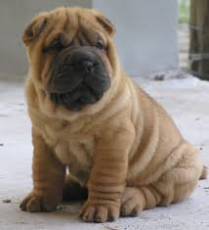

time to decide
So, would you like to be a vet and save animals??
I know I would!!!!
Obviously.
Remember, after a visit to the vet, give your pet a jolly good toy!!!! ☺

Slide 7

FUN FACTS
With 62% of American households owning a pet, it is no secret that veterinarians are in high demand. Veterinary care accounts for 14.37 billion of the total amount of money spent on pet care in 2013.
The term veterinarian comes from the Latin world veterinae which means ‘working animals’.
Dogs are the most popular animal to show up on their veterinary exam table, as 46.3 million households in the United States own a dog!

Slide 8
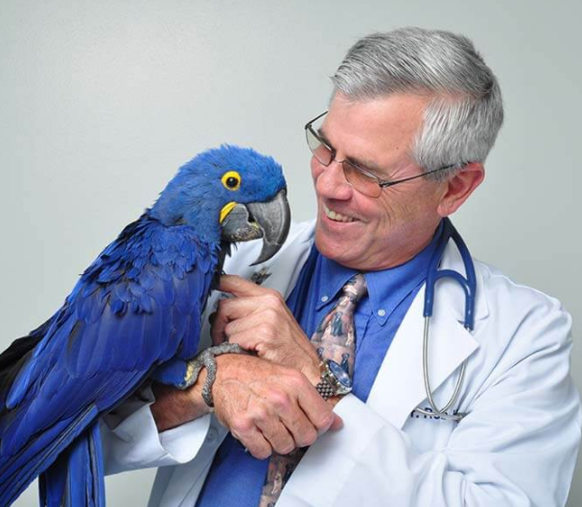
FUN FACTS
Almost 80% of practicing veterinarians are females.
All vets must have a specialty. The most common form would be a general practice with household pets and the occasional surgery needing specialty veterinarian equipment. But, others may go on to complete intensive studies oncology, radiology, animal dentistry, dermatology, cardiology, preventative animal medicine, internal medicine, or exotic small animal medicine and surgery.
Not all vets practice medicine, some work in basic research and development of new treatments.

Slide 9
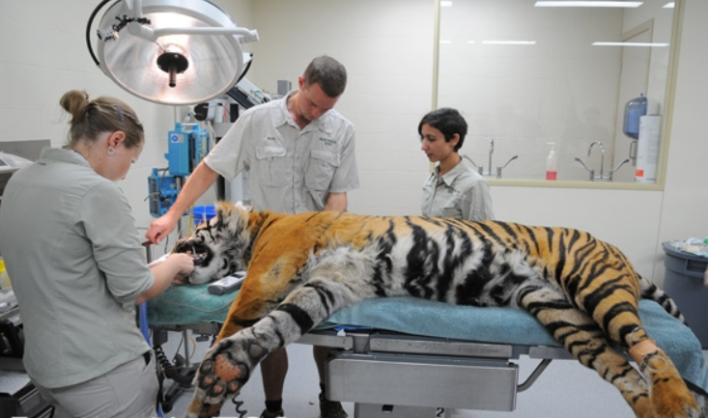

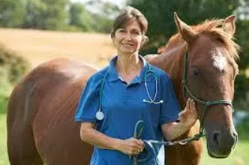
FUN FACTS
Vets must take an oath when they graduate medical school promising they will use their knowledge for the benefit and protection of animal health and welfare. Additionally, they solemnly swear to relieve animal suffering, advance medical knowledge, promote public health, and practice their profession with dignity, while abiding by veterinary medical ethics.
In certain situations, vets can have very dangerous jobs! No matter how well behaved an animal can be, there is no way of telling what can happen on that veterinary exam table.

Slide 10
Bibliography
http://wiki.answers.com
http://animalcareers.about.com
http://everydaylife.globalpost.com
http://www.ask.com
http://education-portal.com
http://careerplanning.about.com

