Slide 1
Circuits & Conductivity Review
Notes:
Random Group Generate 5 groups
Use Eggs pert

Slide 2
Name 3 materials needed to make a working circuit.
Something to use the electricity, such as a light bulb.
Wires to act as a path for the electrons to travel
A power source, such as a battery

Slide 3
Why are wires needed for circuits?
To connect parts of a circuit and provides a path for electrons to travel.

Slide 4
What happens when you have a gap in a series circuit?
All electricity stops flowing and nothing works.

Slide 5
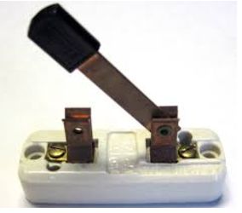
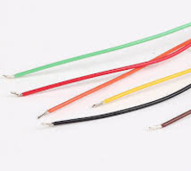
The following materials were gathered to make a circuit. What additional material is needed?
Wires

Slide 6
Why are batteries needed for circuits?
They provide a stream of electrons that creates energy for the circuit.

Slide 7
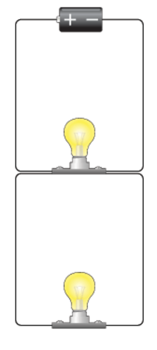
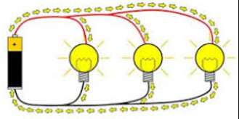
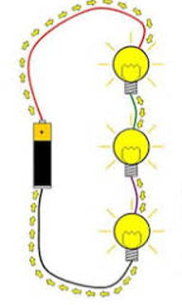
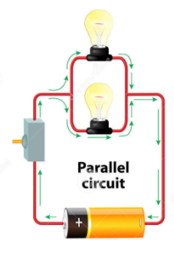
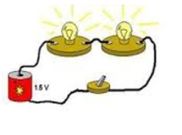
Identify the Series Circuit(s)

Slide 8
What happens when you have a gap in a parallel circuit?
Electricity has multiple paths to take, so other things can still work even with a gap.

Slide 9
Why are switches needed for circuits?
To create a gap in a circuit so electrons will stop flowing. When the circuit closes, the gap disappears and electrons flow again.

Slide 10
Identify the Parallel Circuit(s)

Slide 11
How do Resistors work?
They allow some electrons through but not all of them. A light bulb connected to a resistor would be dimmer than when connected with a conductor.

Slide 12
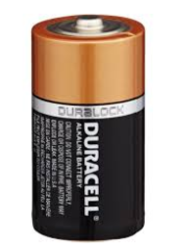
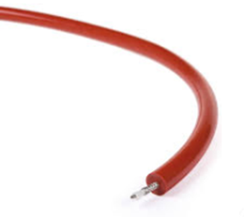
Describe the steps needed to make a working series circuit with one light bulb.
Connect a wire to the negative end of a battery.
Connect a different wire to the positive end of a battery.
Connect each open end of the wires to a light bulb.

Slide 13
Why are light bulbs need in circuits?
To prove that the circuit is conducting electricity.

Slide 14
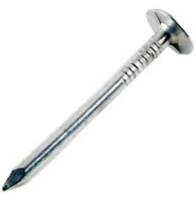
Identify the materials that are good conductors of electricity.
Wax
Salt Water
Rubber
Copper
Wool
Glass

Slide 15
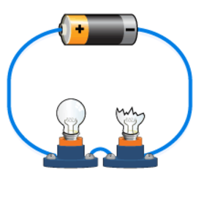
Why does the second light bulb not light up when there is one broken bulb?
This is a series circuit. The broken bulb creates a gap in the circuit. Electrons cannot pass through the second bulb and get back to the battery.

Slide 16
How do insulators work?
They do not allow negative charges (electrons) to pass through them.

Slide 17
Why does the light bulb still light up with one broken bulb?
It is a parallel circuit. The electrons can still flow to the second light bulb because the electrons have multiple paths it can take to get back to the battery.

Slide 18
How do Conductors work?
They allow negative charges (electrons) to flow through them easily.

Slide 19
Identify the materials that are good insulators of electricity.
Wool
Salt Water
Wax
Glass
Rubber
Copper

Slide 20
This review will be posted on my blog this afternoon so you may practice at home!

