Slide 1
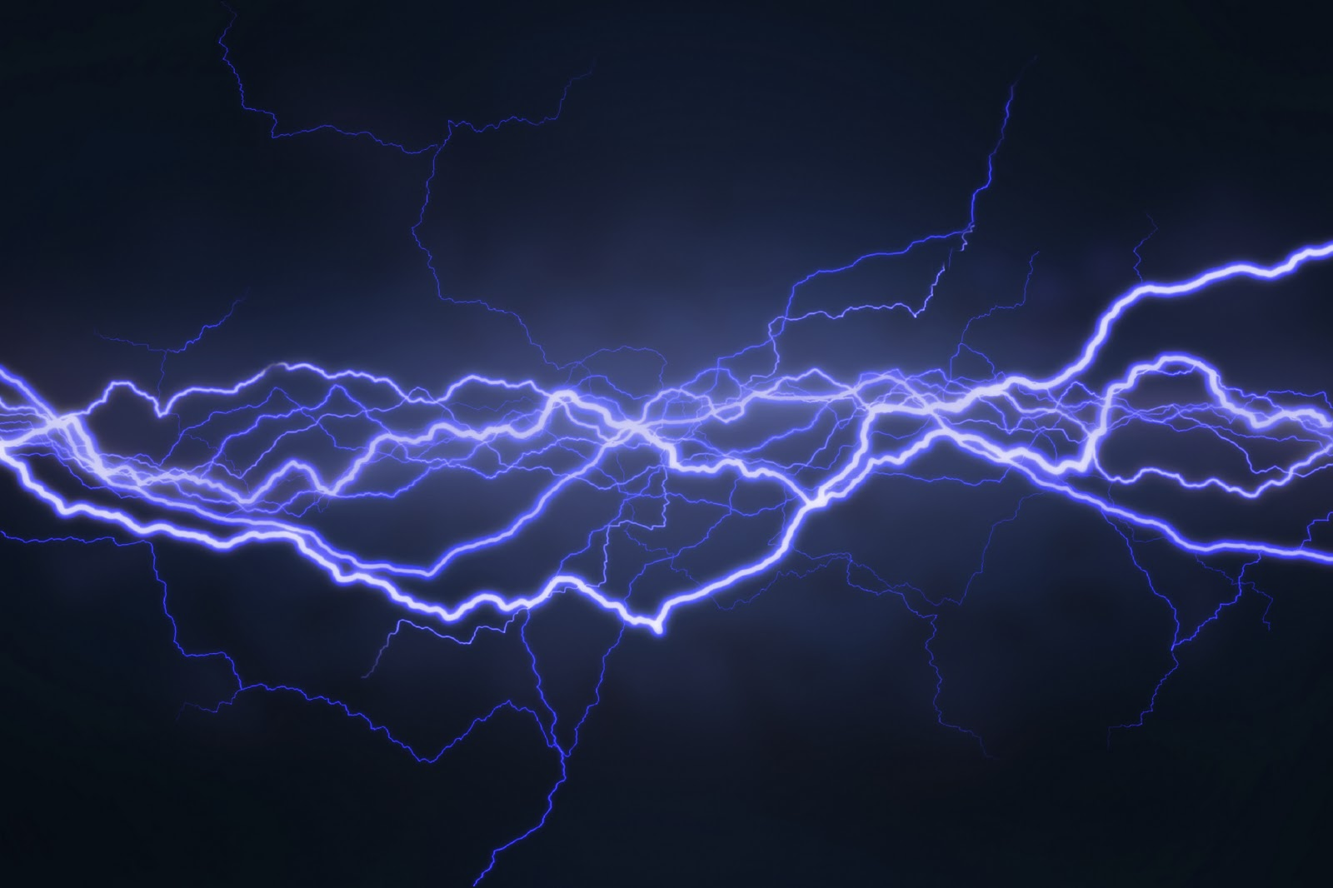
Electricity
Updated 5/7/19

Slide 2
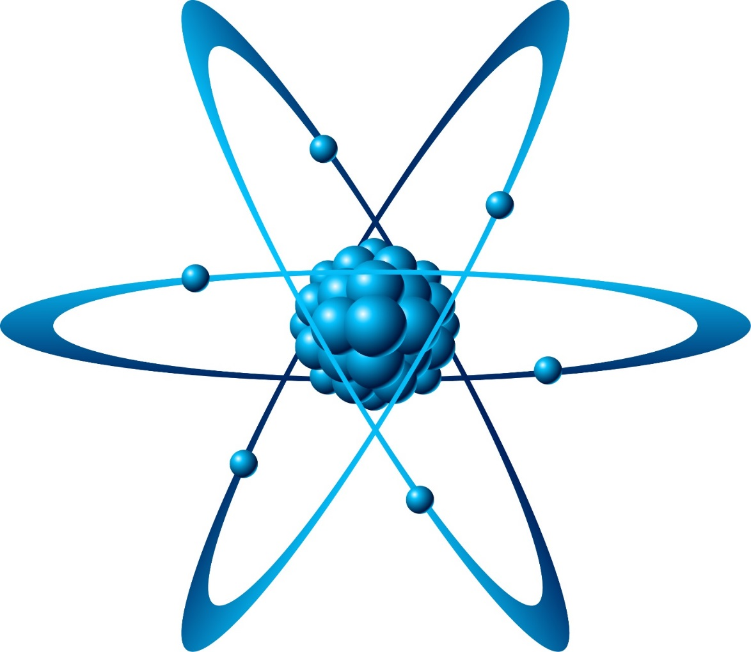
The Atom
Atoms are the smallest known existing thing in the universe. The only thing smaller than an atom are the parts of an atom.
The parts of an atom are
Positively (+) charged Protons ,
No charge (0) Neutrons
Negatively charged (-) Electrons.

Slide 3
Vocabulary
Atom- the smallest part of matter
Nucleus- center of the atom
Proton- The positive charged particle inside the nucleus
Neutron- particles with NO charge, also inside the nucleus
Electrons- negatively charged particles that circle around the nucleus

Slide 4
Static Electricity
Protons and electrons are opposite charges, so they attract each other
Protons repel each other.
Electrons repel other electrons also (making it easy for them to ‘jump’ to other atoms with a more positive charge)
When electrons jump to another material it is called Static Discharge
Examples of static discharge are lightning and being shocked by a metal door handle.
Static Discharge- the jumping of electrons in a sudden burst from one material to another

Slide 5
How does electrical forces follow a complete circuit?
Vocabulary:
Electric Current- the flow of electrical charges
Electric Circuit- the path an electric current takes
Static Electricity will move if it has a path to follow (metal door handle to your finger)
Static Discharge is quick and not a lasting power source. All the electrons flow all at once.
In a battery, electrons always flow away from the negative side to the positive side.

Slide 6
Series & Parallel Circuits
Vocabulary
Series Circuit- a path for electrical current to take that only has one route
Parallel Circuit- a path for electrical current to take that has multiple routes
Series circuits have one circular flow of energy. If one device along the path is removed, the entire flow of electricity stops
Parallel circuits have multiple paths to flow energy to multiple devices. If one device is removed, it does not effect the other devices in the circuit

Slide 7
Diagrams of Circuits
Series Circuit-

Slide 8
Diagrams of Circuits
Series Circuit-

Slide 9
Diagrams of Circuits
Parallel Circuit-

Slide 10
What are insulators and conductors? How are they used?
Vocabulary Words to write in notebooks
Conductor- a material that electrical current can pass through easily
Insulator- a material electrical current CAN NOT pass through
Resistors- materials that cut down (but do not stop) the flow of electrical charges
Filament- wire in the light bulb that heats up and glows
The greater the resistance of something, the less current can get through a circuit.
Thin wires have A LOT of resistance! Light bulbs and toaster wires ‘glow’ because of the resistance.

