Slide 1
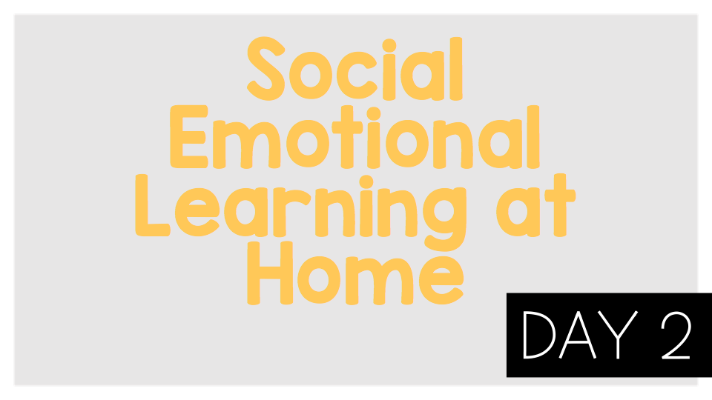
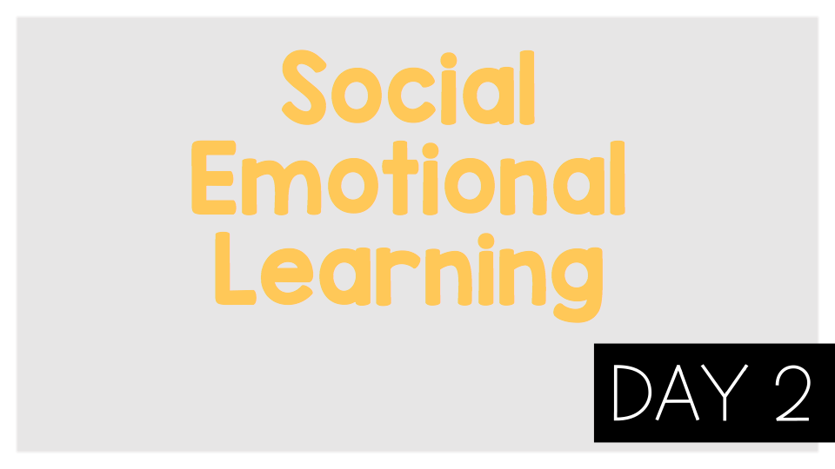
Emotions

Slide 2
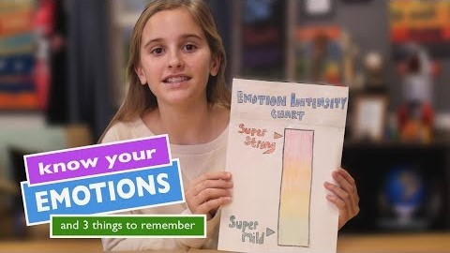
Think:
What emotion or emotions are you feeling right now?
How can you measure your emotions?
Do emotions change or stay the same?
“There are no good or bad emotions.” Do you agree or disagree? Why?

Slide 3
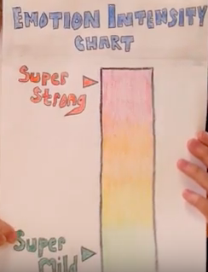
Activity:
Draw your own emotion intensity chart and measure your emotions throughout the day.

