Slide 1
Kindness

Slide 2
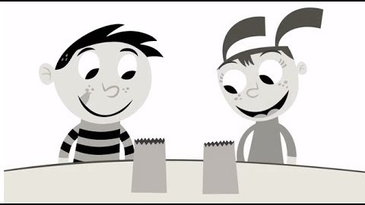
Think:
What do you see happening in the video?
What is happening to add color?
How can you color the world around you?

Slide 3
Activity:
Think of 3 things you can do to “color the world”. Tell them to a trusted adult and then do them if you can.

