Slide 1
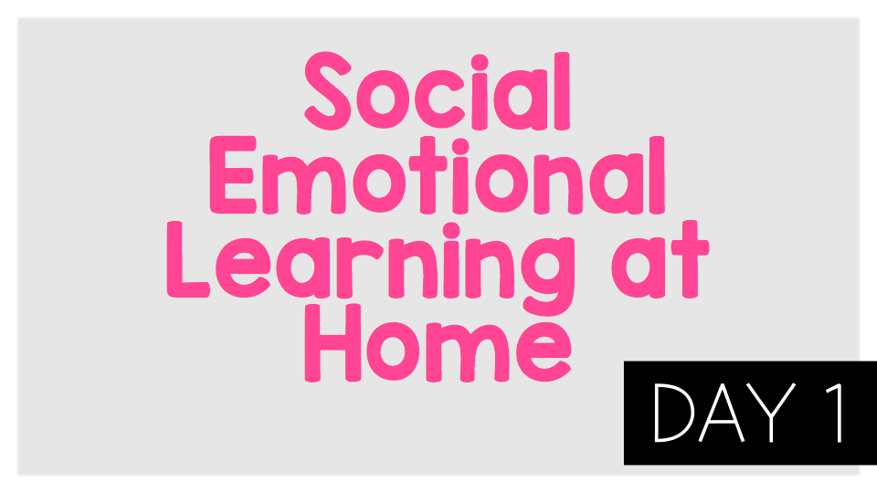
Mental Health

Slide 2

Think:
What are the differences between everyday feelings and overwhelming feelings?
What are some self-care strategies that we can use to deal with everyday feelings, what does Sasha do? does it work?
How are the feelings that André is experiencing different? What does André do to manage these feelings?
What advice does André get from Sasha and his Head of Year?What are some other things André could do?
What can you do if you are worried about a friend?

Slide 3
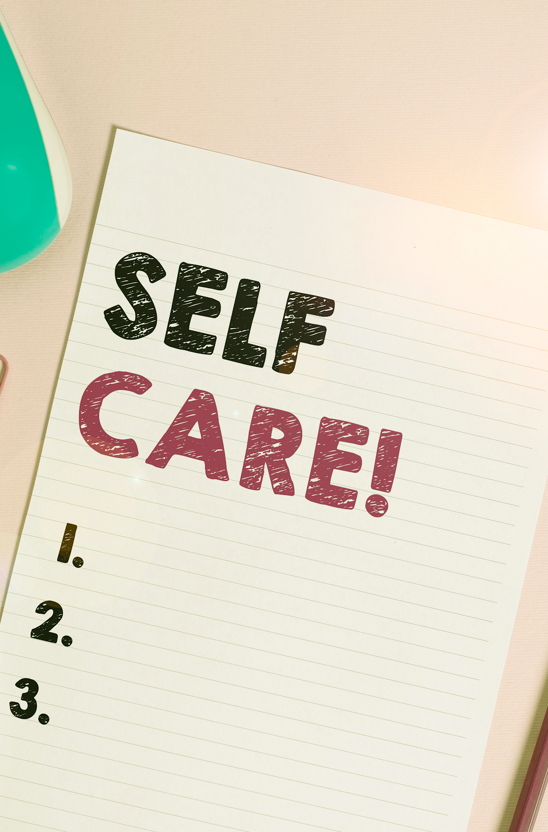
Activity:
As we saw in the video, we all have mental health and we need to take care of our mental health in the same way that we take care of our physical health. What are some of the ways we can take care of our mental health? We call this self-care. Choose one of these self-care strategies to practice now:
Writing
Read a book
Art
Sports or exercise
Playing with a pet
Relaxing
Eating a healthy snack and drinking water
Listening to uplifting music
Talk to a friend or family member

