Slide 1
Emotions lesson 1

Slide 2
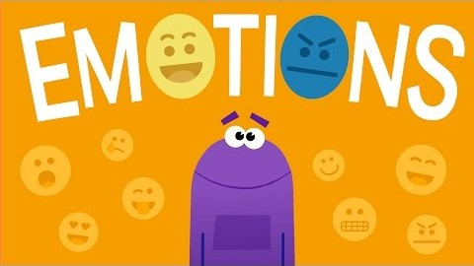
Think:Which emotion are you feeling right now?
What can you do when you are feeling grumpy?
What can you do `when you are feeling sad?
Do:Make a list of all of the things that make you happy.

Slide 3
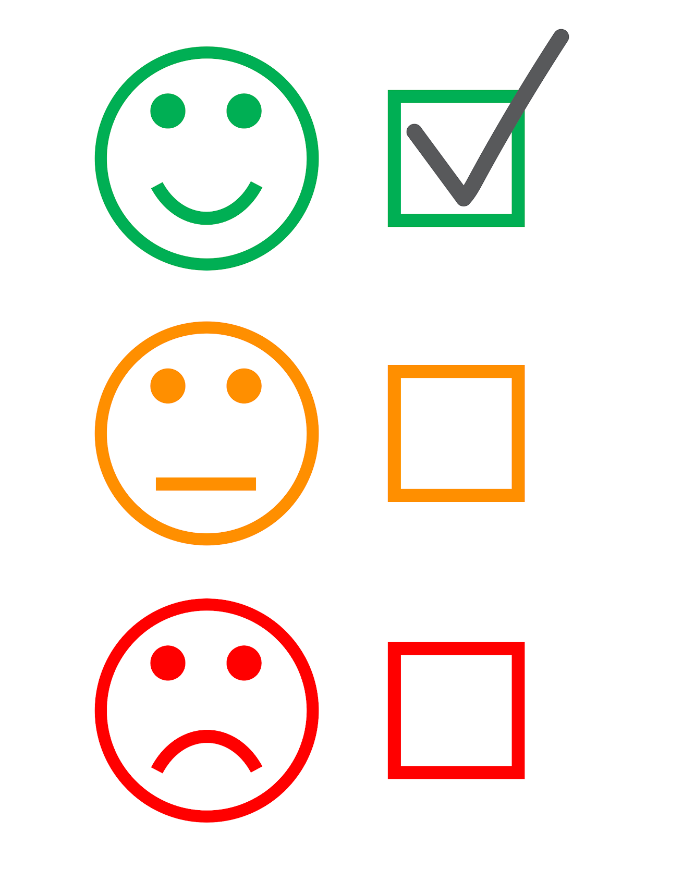
Activity:
Make a list of all the things that make you happy.

