Slide 1
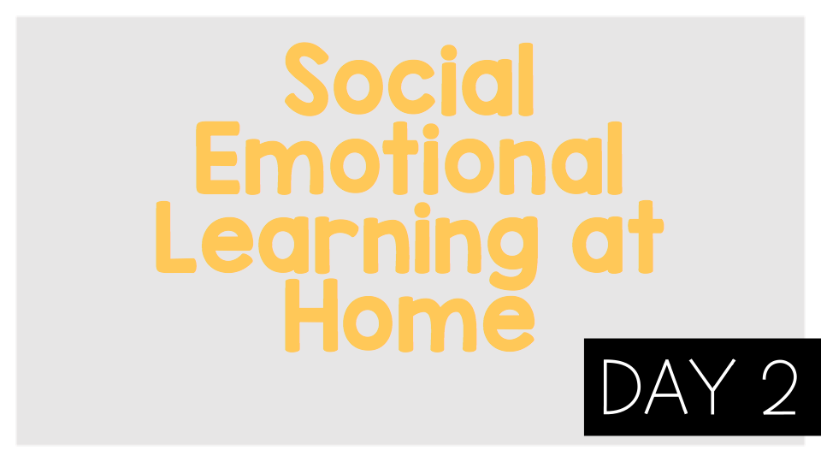
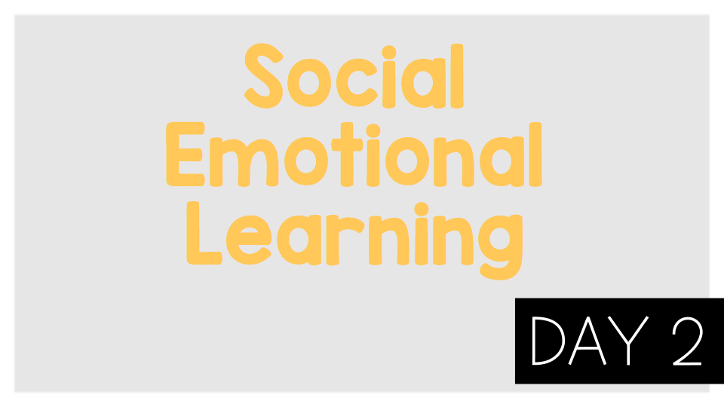
Emotions Lesson 2s

Slide 2
Think:
How does a person’s face change based on their emotion? How does a person’s body change based on their emotion?
Which of these emotions are you feeling the most right now?

Slide 3
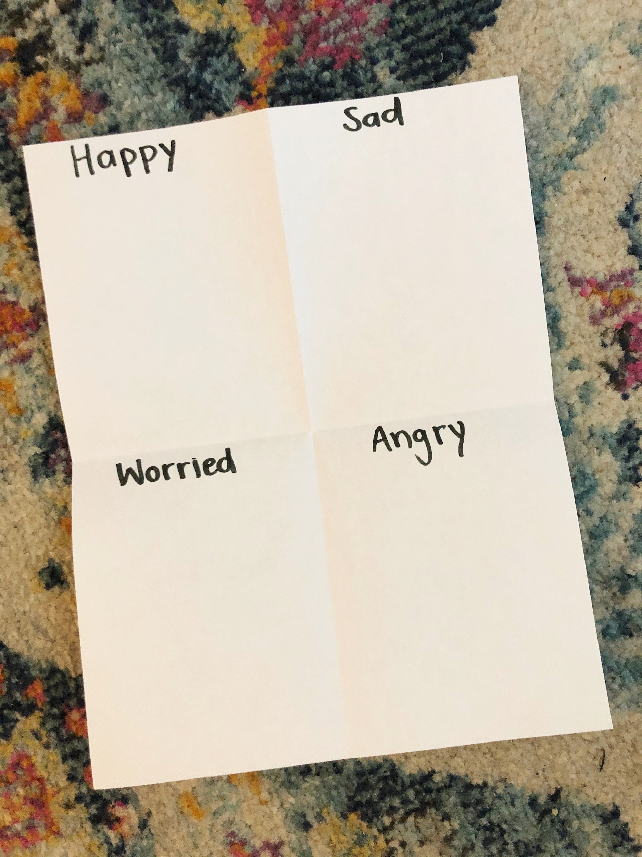
Activity:
Fold a piece of paper in half 2 times. Write one of the following emotions in each square: happy, sad, worried, angry. Draw a picture of yourself showing each emotion.

