Slide 1
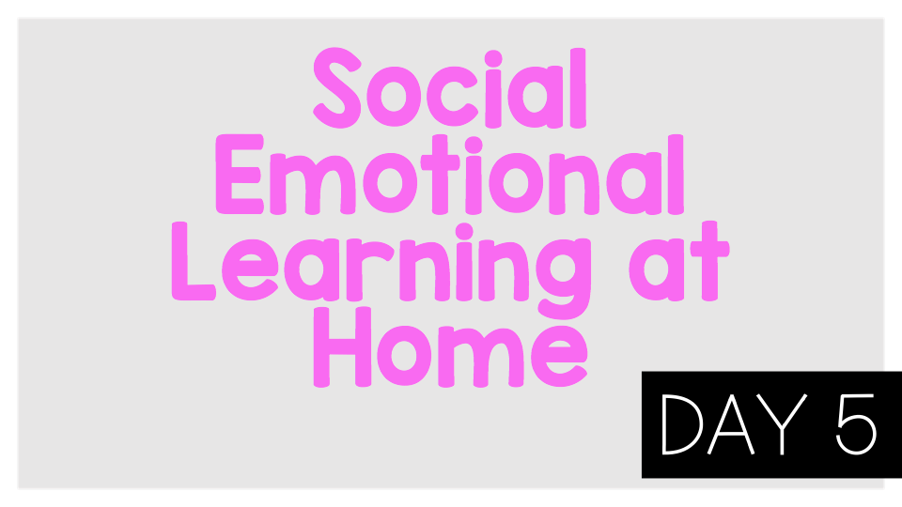
Worry lesson 2

Slide 2
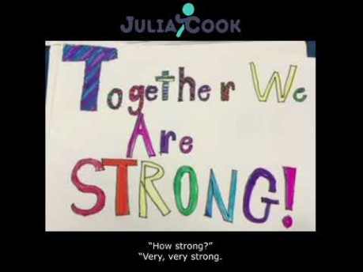
Think:Are you worried about “yucky bugs”?
What does it mean to say that together we are strong?
Do you have control over the “yucky bug”?
What can you do to help control the “yucky bug”?
Do:Always talk to a trusted adult if you are worried about something.

Slide 3
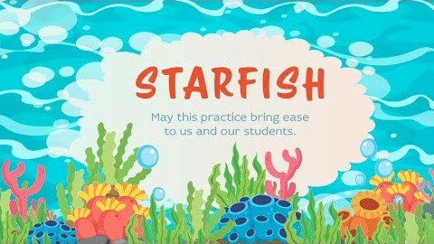
Think:
What are some things that make you feel nervous or worried?
When you are nervous or worried what can you do to feel better?
Do:
Practice the starfish breathing strategy along with the video.

Slide 4
Activity:
Write a story or draw a picture about something you are worried about. Share the story or picture with a trusted adult.

