Slide 1
The Atom and Static Electricity Review

Slide 2
Correctly label this atom with it’s parts.
Electron
Proton
Nucleus
Neutron

Slide 3
Which part of the atom can move to other atoms?
Electrons. Protons and Neutrons do not move to other atoms.

Slide 4
What does rubbing or fiction do to an object?
Removes electrons, causing the object to become positively charged.

Slide 5
If a glass rod gets rubbed with a cloth and becomes positively charged, what happens to the cloth?
The cloth becomes the opposite- negatively charged.

Slide 6
What is Electrical Force?
When electrically charged objects attract or repel each other.

Slide 7
How do two negatively charged objects react to each other?
They repel away from each other.

Slide 8
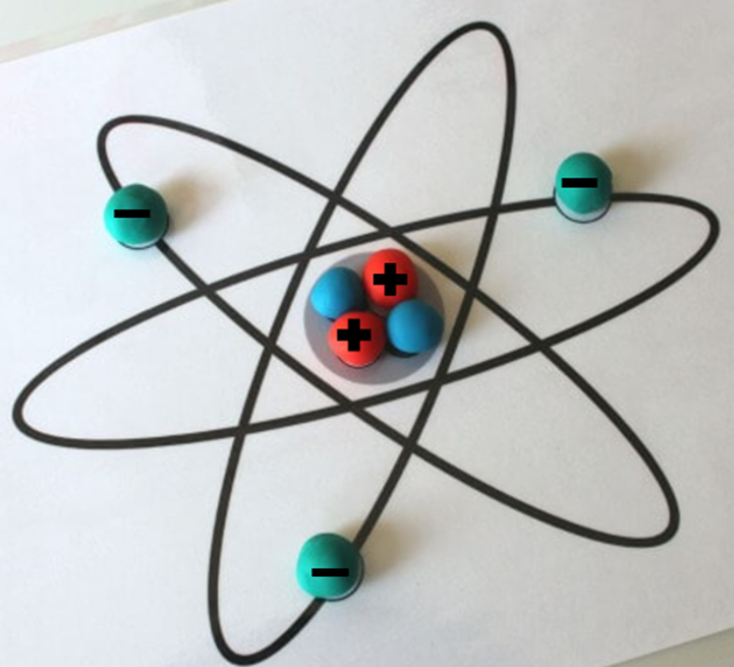
Why is this considered a Negatively charged atom?
It has more electrons than protons

Slide 9
How do two objects with opposite charges (one positive, one negative) react to each other?
They attract towards each other.

Slide 10
How does an object become positively charged?
It loses electrons.

Slide 11
What is Static Discharge?
When two objects have an imbalance of charges. The electrons move to the positively charged object. Both objects then become neutrally charged and balanced.

Slide 12
What is the Electrical Field?
The area surrounding an object where electrical forces occur.

Slide 13
How can you make this atom neutrally charged?
Remove one electron.

Slide 14
Name 3 examples of Static Electricity.
Laundry that gets stuck together
The toothpick and spoon experiment
The spoon and pepper experiment
Hair sticking up
Balloons moving soda cans

Slide 15
How do two positively charged objects react to each other?
They repel away from each other.

Slide 16
How can you create a stronger Electrical Force?
By placing the electrically charged objects closer to each other. The closer they are, the stronger the force. The further away they are, the weaker the force.

Slide 17
Explain what happens during Static Discharge.
Static Electricity builds up, and then electrons move in a burst to another object.

Slide 18
How is lightning formed?
Static Electricity builds up in clouds, then Static Discharge occurs when the electrons leave the cloud and go to a positively charged area.

Slide 19
How can you make this atom positively charged?
Remove two electrons.

Slide 20
This review will be posted on my blog this afternoon so you may practice at home!

